Slide 1

DEPARTMENT OF INFORMATION TECHNOLOGY
Internet of Things

Slide 2
Topic
Physical Design of IoT

Slide 3
Physical Design of IoT
The "Things" in IoT usually refers to IoT devices which have unique identities and can perform remote sensing, actuating and monitoring capabilities.
IoT devices can:
  Exchange data with other connected devices and applications (directly or indirectly), or
  Collect data from other devices and process the data locally or
  Send the data to centralized servers or cloud-based application back-ends for processing the data, or
  Perform some tasks locally and other tasks within the IoT infrastructure, based on temporal and space constraints

Slide 4
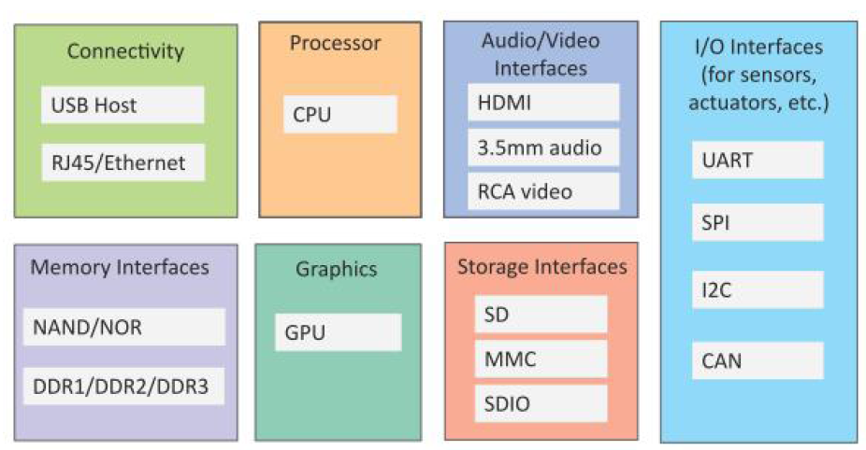
Generic Block Diagram for IoT Device

Slide 5

Information exchange….
Various Interfaces,
  IO interfaces for sensors
  Interfaces for Internet connectivity
  Memory and Storage Interfaces
  Audio/Video Interfaces

Slide 6
UART (Universal Asynchronous Receiver / Transmitter)
Main purpose is to transmit and receive
Simple and most commonly used serial communication technique
Older computer devices like mouse, printer and modem use connected using a heavy connector.
Now, GPS receiver, bluetooth GSM, GPRS.

Slide 7
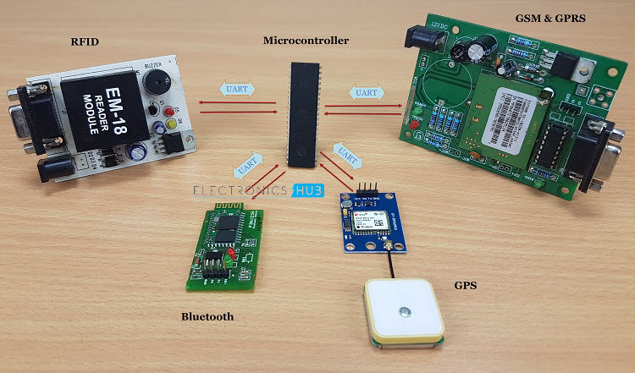
UART (Universal Asynchronous Receiver / Transmitter)

Slide 8
SPI (Serial Peripheral Interface)
SD card modules, RFID card readers.
One benefit is that the data can be transferred without any interruption.
Single master connects multiple slaves.

Slide 9
I2C (Inter Integrated Circuit)
I2C is a serial protocol for two-wire interface to connect low-speed devices.
Combines the features of SPI and UART.
Connect multiple slaves with single master
Multiple master can control single slave or multiple slaves,

Slide 10
CAN (Controller Area Network)
CAN is basically used in communication among different devices in a low radius region, such as in an automobile
It is a CSMA-CD protocol.

Slide 11
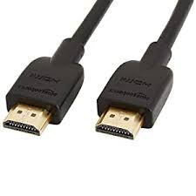
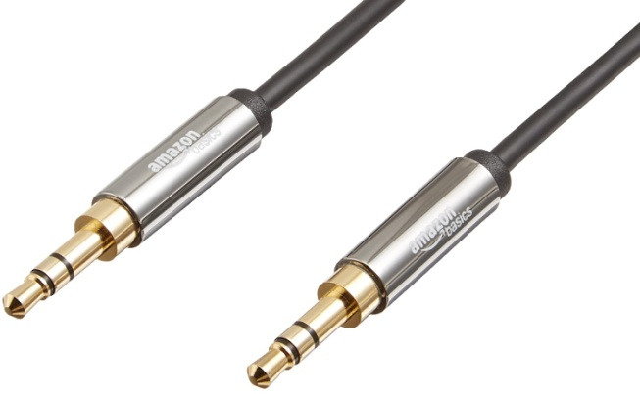
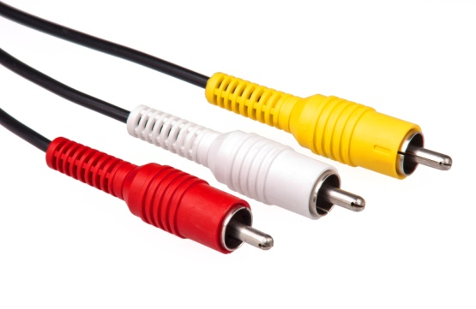
Audio / Video Interfaces

Slide 12
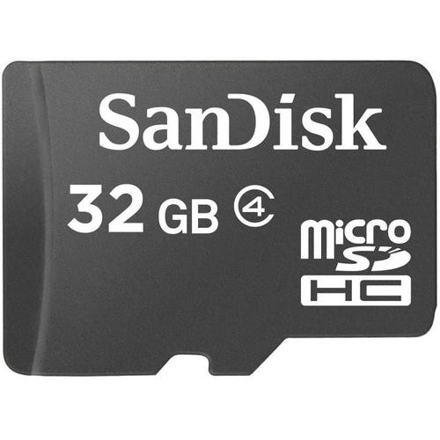
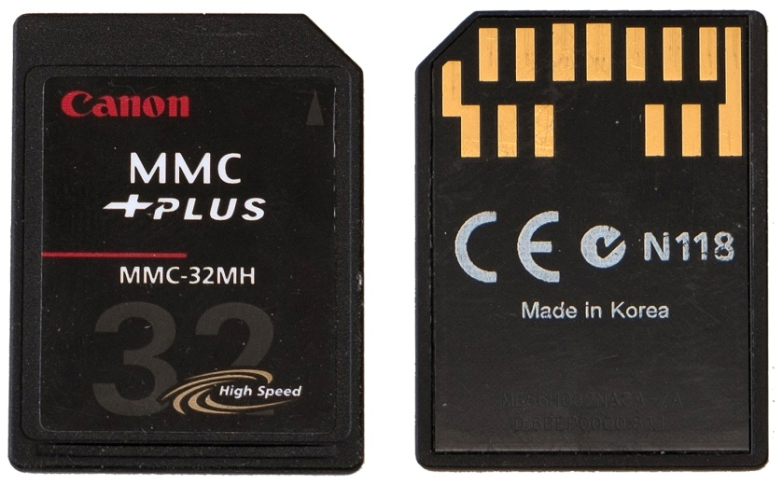
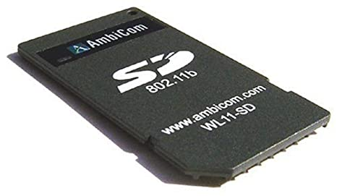
Storage Interfaces

Slide 13
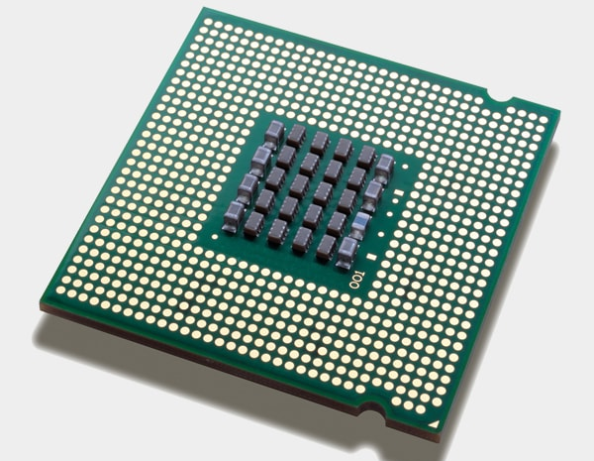
Processor

Slide 14
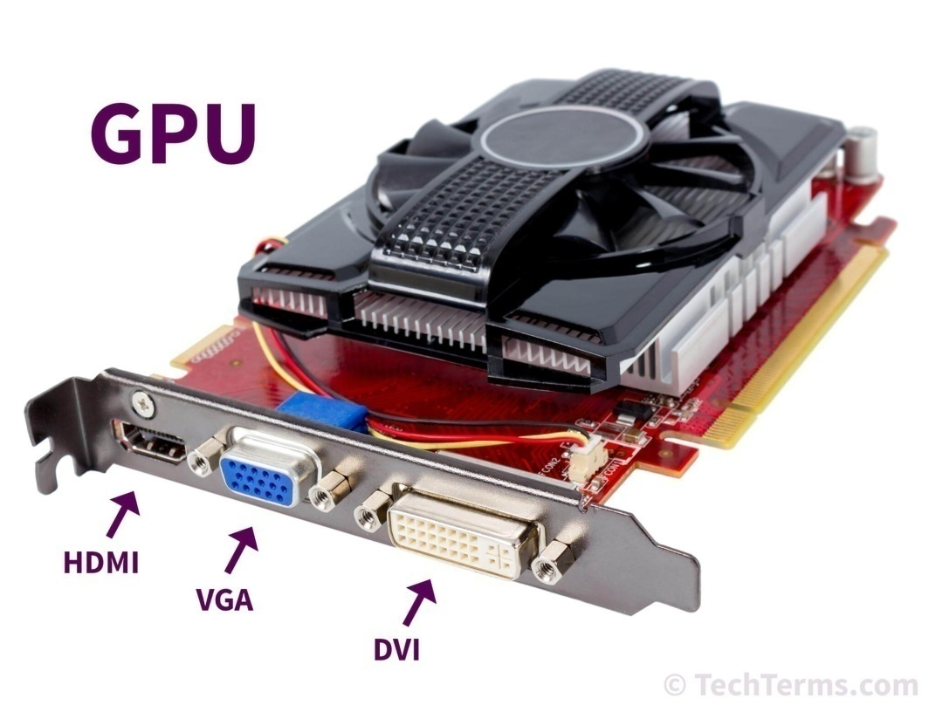
Graphics

Slide 15
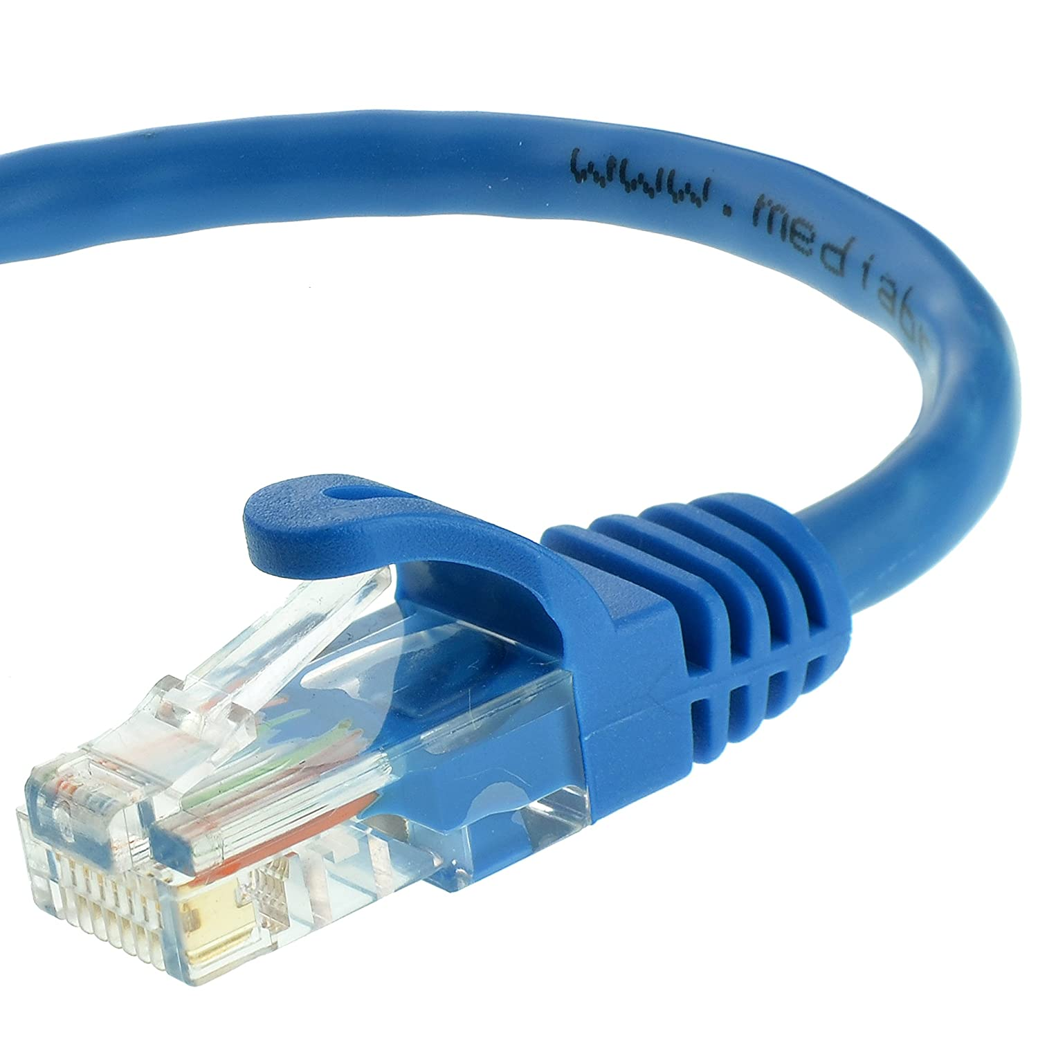
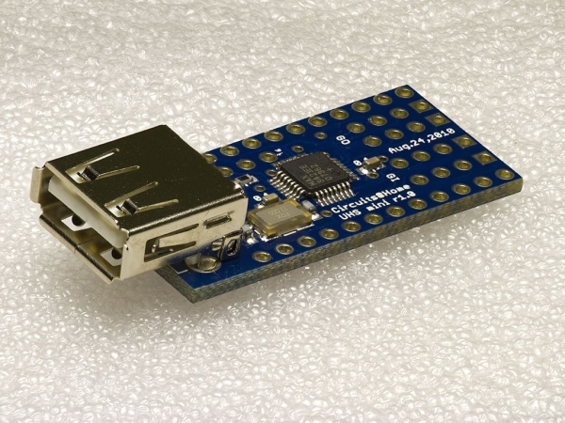
Connectivity

Slide 16
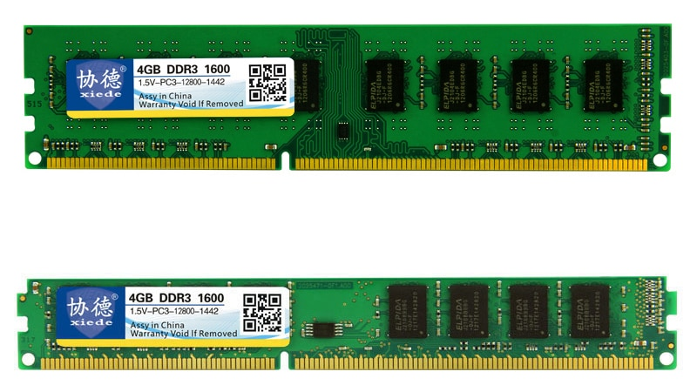
Memory Interfaces

Slide 17
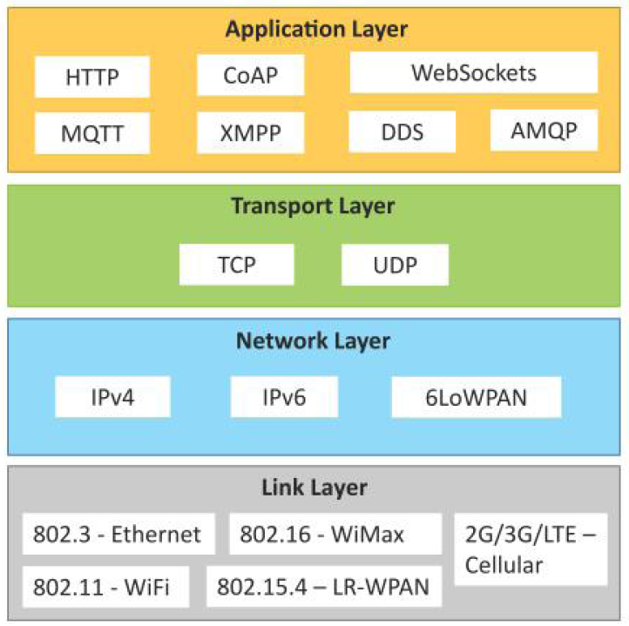
Protocol Architecture

Slide 18
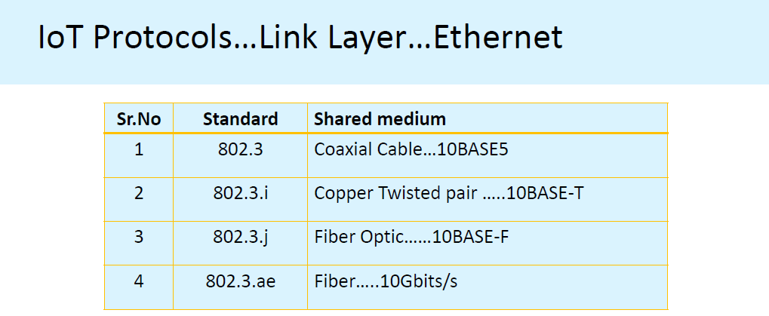

Slide 19
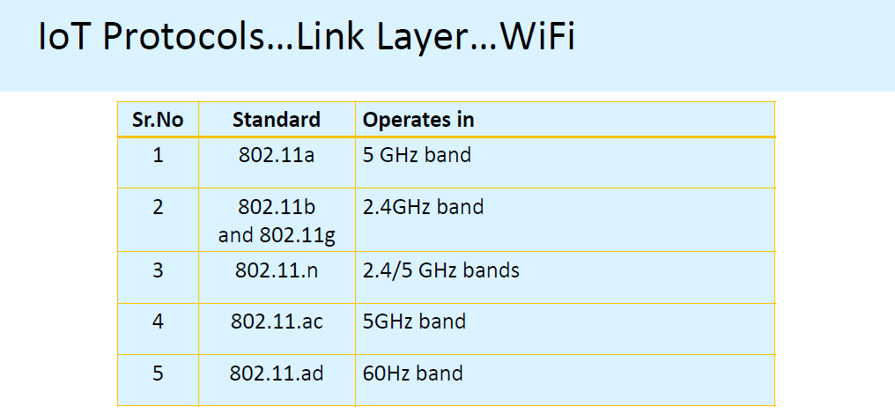

Slide 20
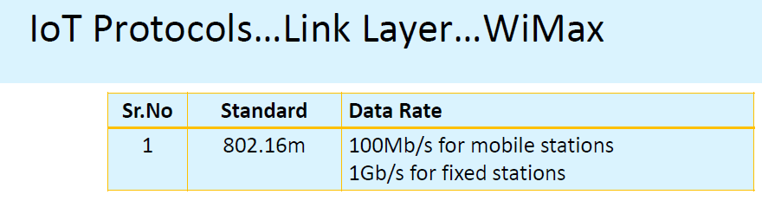

Slide 21
Ethernet
Data rates provides from 10GBPS to 40GBPS.
WIFI
Collection of Wireless LAN
Data rates from 1 MBPS to 6.75 GBPS
LR-WPAN
Collection of Low – rate wireless Personal Area Networks
Data rate from 40 kb/s to 250 kb/s
Provide low cost and low speed communication for power constrained devices.

Slide 22
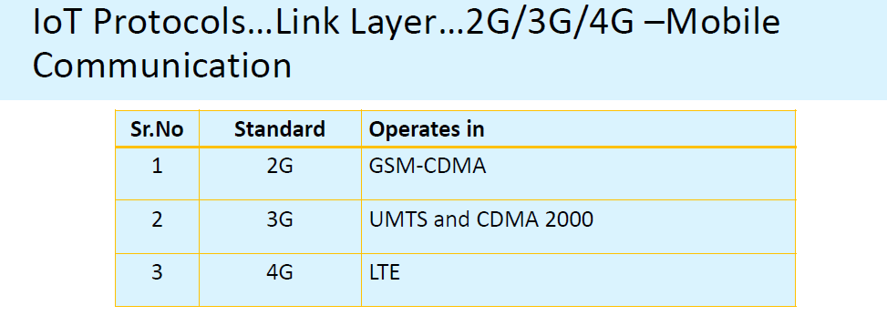
Data rate from 9.6 KBPS to 10MBPS

Slide 23
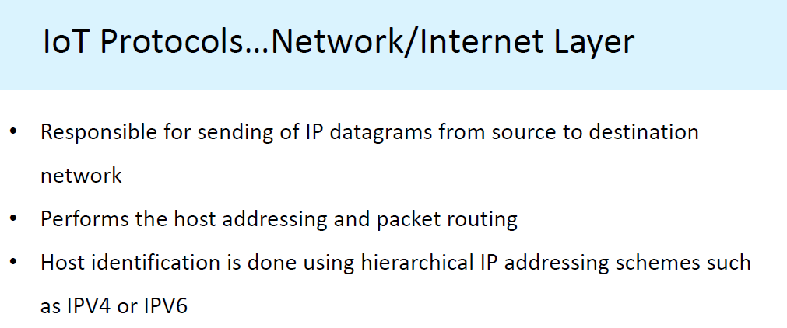

Slide 24
Network Layer
IPV4
  Uses 32 bit address scheme
IPV6
  Uses 128 bit address scheme
6LoWPAN
  Used for devices with limited processing capacity
  Operates in 2.4 Ghz
  Data rates of 250 Kb/s

Slide 25
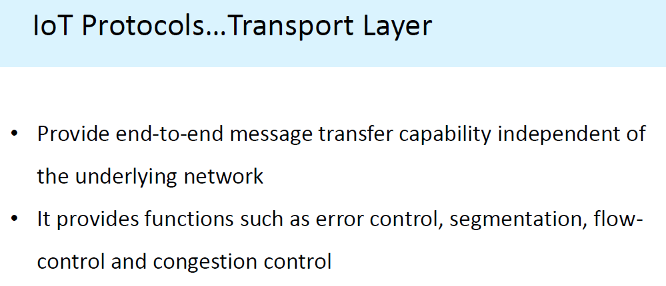

Slide 26
Application Layer
Application Layer Protocols define how the applications interface with lower layer protocols to send the data over the network.
Files Encoding Processes…
HTTP – Hyper Text Transfer Protocol
      Base of WWW
      HTTP combines GET, PUT, POST, DELETE, HEAD, TRACE, OPTIONS etc
      Thus it follows “request – response Model”
      Client can be Brower/application running on client.
      HTTP uses URIs to identify HTTP resources.
      Stateless protocol; each request is independent.
Notes:
URI – Universal Resource Identifier

Slide 27
GET is used to request data from a specified resource. (no updating)
  remain in the browser history
POST is used to send data to a server to create/update a resource.
  do not remain in the browser history
PUT is used to send data to a server to create/update a resource.
  Calling the same PUT request multiple times will always produce the same result. In contrast, calling a POST request repeatedly have side effects of creating the same resource multiple times.

Slide 28
HEAD is almost identical to GET, but without the response body.
  If GET /users returns a list of users, then HEAD /users will make the same request but will not return the list of users.
The DELETE method deletes the specified resource.
OPTIONS method describes the communication options for the target resource.
'TRACE' is a HTTP request method used for debugging which echo's back input back to the user.

Slide 29
URI Syntax
A Uniform Resource Identifier (URI) is a string of characters that uniquely identify a name or a resource on the internet.
A URI identifies a resource by name, location, or both. URIs have two specializations known as Uniform Resource Locator (URL), and Uniform Resource Name (URI).
A Uniform Resource Locator (URL) is a type of URI that specifies not only a resource, but how to reach it on the internet
Uniform Resource Name (URN) is a type of URI that uses the specific naming scheme of urn
[//[user:password@]host[:port]][/]path:[?query][#fragment]

Slide 30
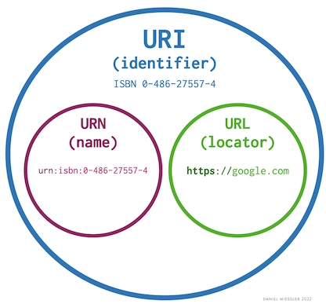
A URI is an identifier of a specific resource. Examples: Books, Documents
A URL is special type of identifier that also tells you how to access it. Examples: HTTP, FTP, MAILTO
If the protocol (https, ftp, etc.) is either present or implied for a domain, it is URL—even though it’s also a URI.

Slide 31
Application Layer
CoAP – Constrained Application Protocol (CoAP) is a specialized web transfer protocol for use with constrained nodes and constrained networks in the internet of Things (IoT).
Devices with limited resources like memory, processing capacity, and power are called constrained nodes.
Designed for M2M applications.
Uses UDP, with Client-Server architect like HTTP.
“Constrain” – “Nodes”
Notes:
Low power, lossy Networks

Slide 32
Application Layer
Web Socket – allows Full Duplex Communication over a single socket connection for sending messages between client and server.
  Uses TCP;
  Client can be a browser, Mobile APP or an IoT Device
MQTT – Message Queue Telemetry Transport (MQTT) is a light weight messaging protocol based on the publish – Subscriber Model.
  Server called MQTT Broker
  Well suited for constrained environment
  Uses TCP;

Slide 33
Message Queue Telemetry Transport (MQTT)
MQTT today is used in a wide variety of industries, such as automotive, manufacturing, telecommunications, oil and gas, etc.
MQTT allows for messaging between device to cloud and cloud to device. This makes for easy broadcasting messages to groups of things.
MQTT can scale to connect with millions of IoT devices.

Slide 34
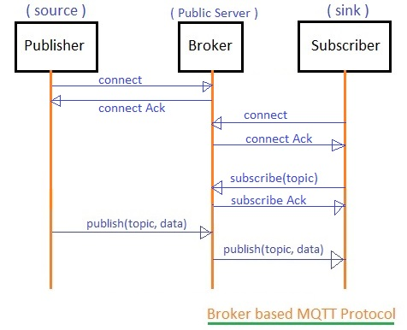

Slide 35
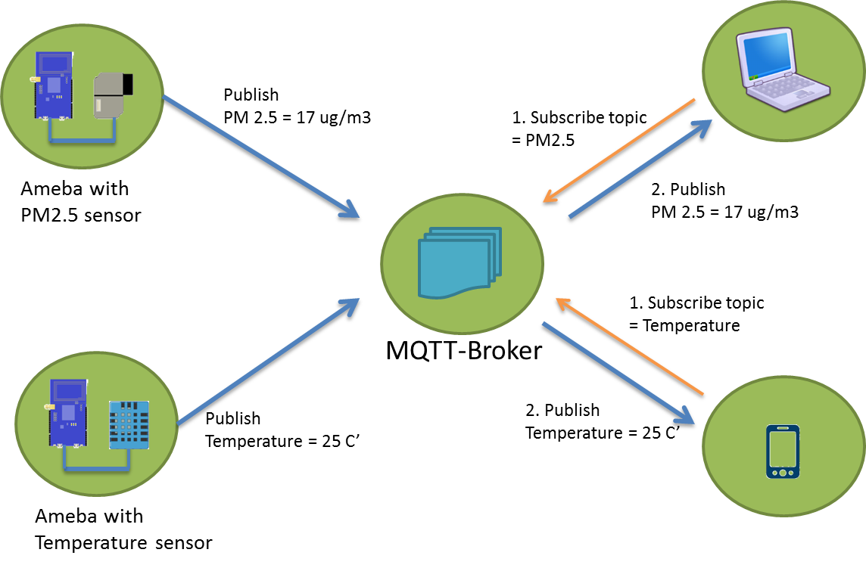

Slide 36
QOS
Quality of Service (QoS) manages network capabilities and resources to provide a reliable backbone to IoT connectivity.
In order to offer secure and predictable services, QoS will manage delays, delay variation, bandwidth and packet loss by classifying traffic and registering channel limits.
QoS parameters of the application layer are Service Time, Service Availability, Service Delay, Service Accuracy, Service Load, Service Priority, Information Accuracy, and Cost of Network Deployment.

Slide 37
QOS0-
  Fire and Forget –
  recipient does not ack-
  Atmost once
QOS1
  Sender sends the mesg and waits for the ack from the receiver
  Atlease once.
QOS2
  Guarantee is provided by atleast 2 request/response flow.
  Exactly once.

Slide 38
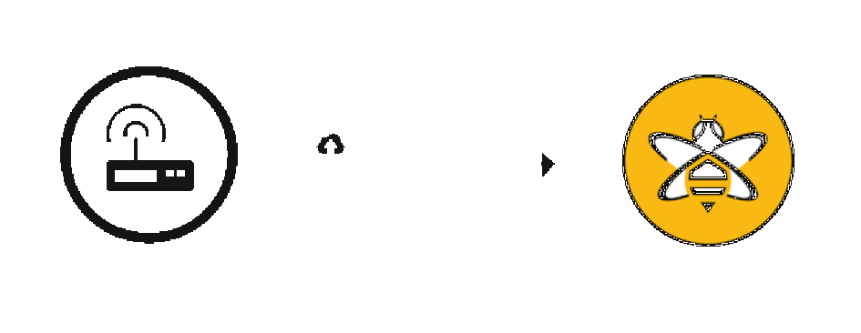
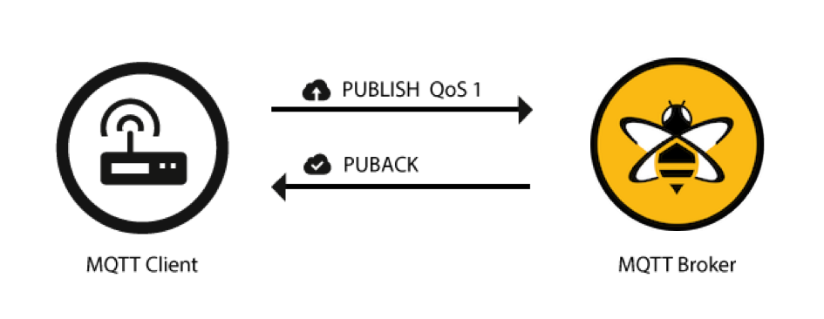
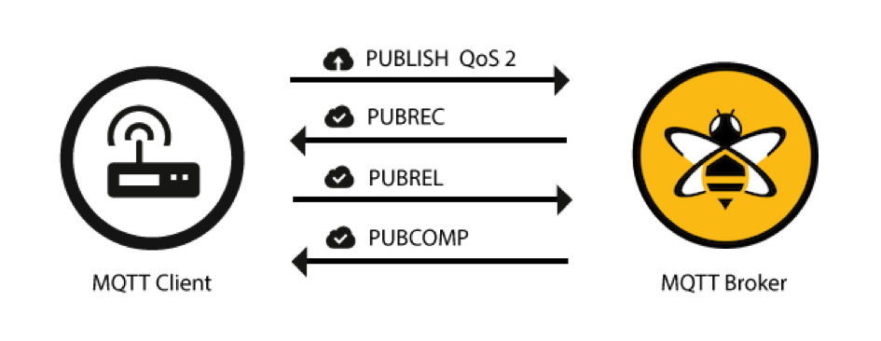
QoS
QoS 0
QoS 1
QoS 2

Slide 39
Application Layer
XMPP – Extensible Messaging and Presence Protocol
  For real time communication and streaming XML data between network entities;
  Supports both client –server as well as server-server commn paths
  Real time communication between IoT devices.
  Multi party chat, voice/video call.
DDS – Data Distribution Service
  A data centric middleware standard for D2D or M2Mcommunication.
  Publisher (devices generates topics to subscribe) - Subscribe Model( devices wish to consume data)
  Alike MQTT Broker-less; Uses UDP
.

Slide 40
AMQP – Advanced Message Queuing Protocol
  Point to Point & Publisher Subscribe
  Open AL protocol for business messaging
  AMQP broker receives messages from publisher and route them over connection to consumers.
  Publishers publish the message to exchange which then distribute message copies to Queues.
  Messages are either delivered by the broker or consumer can pull the message from the queue. ( push-pull communication model)

Slide 41
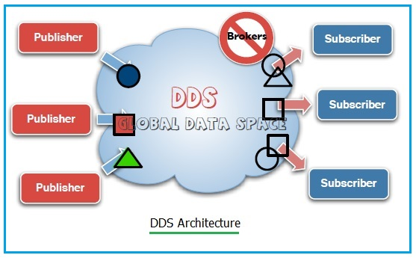

Slide 42
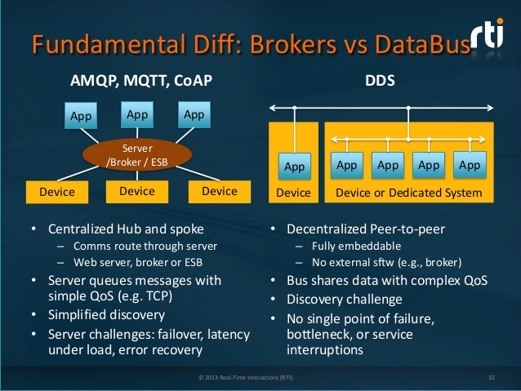

Slide 43
